Slide 1
Electronic Voting Machine
Course: CSE299(Junior Design), Section: 11, Faculty: ITN
Team Name: Team Venom
Name of the Members:
1.Tazbin Hossain Zadid – 1520683042 (tazbin.zadid@northsouth.edu)
2. Sadman Alam - 1610544042 (sadman.alam@northsouth.edu)

Slide 2
Abstract
Voting is the fundamental right for each citizen of a country. The same scenario is also noticed in our country. Bangladesh is a democratic country. So, in a democratic country like ours every eligible citizen has the right to choose his/her preferred candidate. For that to be happened we need to make sure that the election process is fair and accurate.
So, for making the election process fair and accurate we need to change the current system. Currently, votes are taken manually in our country. The manual system is not very accurate and fair enough. There is always a chance of cheating and misconduct in the current system. So, for avoiding those scenarios we are proposing a device named “ELECTRONIC VOTING MACHINE”. We hope it will solve almost all the problems and election results will be fair and accurate.

Slide 3
Introduction And background
Electronic Voting Machine (EVM) is a device by which people can give their votes digitally. Because of using this system we don’t have to use ballot papers, ballot boxes, markers etc. EVM is very easy to use. The manual system was difficult to understand for some people but EVM is very easy to understand for everyone. In the past, there was always a speculation of cheating and misconduct in any election of our country. So, for changing the history we definitely need something like EVM.
EVM is an electronic device which will have some buttons. There will be separate button for each party and also there will be a button for calculating result. Each voter will press his desired button and the information will be saved. So, the mechanism of the device is very much simple. We can say that EVM will be a history changing device and everybody will like it.

Slide 4
Objectives
The objectives of this project are :
People will press a button of the machine and give their valuable vote whoever they want.
The machine will store the information, and calculate the amount of total votes.
The final result of the election will be displayed on the LCD screen of this machine.

Slide 5
Components
The components used in this project are :
Arduino Uno
16x2 LCD
Push Button
Bread Board
Power
Connecting Wires
Finger Print Module

Slide 6
Scopes
In this project we have used four push buttons for four different candidates. We can increase the number of candidate but for better understanding we have limited it to four. When any voter press any of four button then respecting voting value will increment by one each time. After whole voting we will press result button to see the results. As the "result" button is pressed, Arduino calculates the total votes of each candidate and show it on the LCD display.

Slide 7
ScOPES
Push Buttons
Arduino
16x2 LCD
AWM
BNP
JP
FINGERPRINT SENSOR R307
E
RESULT
D
u
d
M

Slide 8
Methodology
In this project, we will use some components which are mentioned in one of the previous slides. Among those components some can cause little problems.
The Arduino Uno could have become wasted. If it becomes then we’ll need a new one. That’s why we need to keep one extra.
The LCD screen could have also become wasted. So, we need to keep extra LCD screens.
The push buttons could have also become wasted. So, it will be good for us if we keep alternative push buttons.
We have tried to be careful during constructing this project as it is a hardware project.

Slide 9
Use OF Components
This project contains Arduino, push buttons and LCD. Arduino controls the complete processes like reading button, incrementing vote value, generating result and sending vote and result to LCD. Here we have added five buttons in which first button is for CAN1, second is for CAN2, third is for CAN3. The last button is used for calculating or displaying results.
We need a code to operate Arduino. The code is simple one and it is written in C++. We just have to connect the code to the Arduino through a USB port and it will start to work.
One notable thing is we have used the Adafruit Fingerprint Library to interface the fingerprint module with the Arduino Uno.

Slide 10
BUDGET (could be edited in the future)
Item | Cost
Arduino Uno | BDT 820.00
16X2 LCD | BDT 350.00
Push Buttons | BDT 40.00
Breadboard | BDT 255.00
Wires | BDT 120.00
LEDs | BDT 6.00
Resistors | BDT 12.00
Fingerprint module | BDT 2200.00
Total | BDT 3803.00

Slide 11
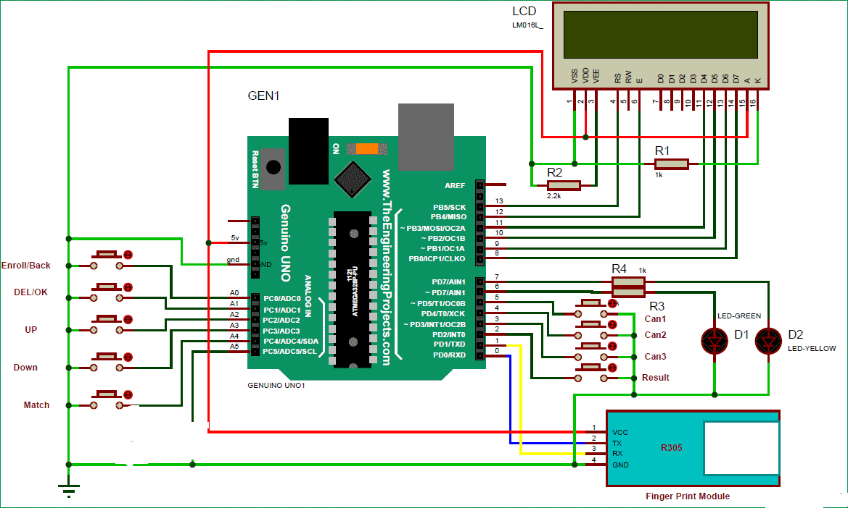
Diagram

Slide 12
Expected Outcomes
By operating this machine, we will get the final result of the election and the final result will be displayed on the LCD screen. The result must be accurate and precise.

Slide 13
Additional feature
We have added a fingerprint sensor to our project. In this system, a voter will be recognized by his fingerprint and once a voter is recognized then he is free to cast his vote through our machine.
At first, it was not in our plan but for improving our project we have decided to add that also. It’s true that our work rate increased because of that but definitely our project became precise only for that thing.

Slide 14
COnclusion
We really have worked hard to construct this project. Also, we have enjoyed a lot in completing this project. It’s true that we have faced some difficulties while doing this project. Inspite of having those difficulties we have tried to complete our project.
Hopefully, our ELECTRONIC VOTING MACHINE will give accurate and precise calculation of votes.

Slide 15
THANK YOU VERY MUCH !!!!!!

